Slide 1
Arduino Interrupt
For more information on interrupts, see Nick Gammon’s notes.

Slide 2
What is an Interrupt
Most processors have interrupts.
Interrupts let hardware respond to "external" events while doing something else.
For example, if you are cooking dinner you may put the potatoes on to cook for 20 minutes.
Rather than staring at the clock for 20 minutes you might set a timer, and then go watch TV. When the timer rings you "interrupt" your TV viewing to do something with the potatoes.

Slide 3
When writing an Interrupt Service Routine (ISR)
Keep it short
Don't use delay ()
Don't do serial prints
Make variables shared with the main code volatile
Variables shared with main code may need to be protected by "critical sections"
Don't try to turn interrupts off or on

Slide 4
Constant Definitions
All the symbolic constants used in the following slides or programs are already defined somewhere in the included files in the avr library.
Don’t worry, just use them.

Slide 5
The ISR attach function
attachInterrupt(digitalPinToInterrupt(pin), ISR, mode) where:
digitalPinToInterrupt(pin): the external pin number of the interrupt.
ISR: the interrupt service routine to call when the interrupt occurs; this function must take no parameters and return nothing.
mode: defines how the interrupt should be triggered. Four constants are predefined as valid values:
LOW to trigger the interrupt whenever the pin is low,
CHANGE to trigger the interrupt whenever the pin changes value
RISING to trigger when the pin goes from low to high,
FALLING for when the pin goes from high to low.

Slide 6
Example of interrupts
const byte LED = 13;
const byte BUTTON = 2;
// Interrupt Service Routine (ISR)
void switchPressed () //Interrupt Service Routines are functions with no arguments.
{
if (digitalRead (BUTTON) == HIGH)
digitalWrite (LED, HIGH);
else // Connect a wire (or switch) between D2 and Ground
digitalWrite (LED, LOW);
} // end of switchPressed
void setup ()
{
pinMode (LED, OUTPUT); // so we can update the LED
digitalWrite (LED, HIGH);
digitalWrite (BUTTON, HIGH); // internal pull-up resistor
attachInterrupt (digitalPinToInterrupt (BUTTON), switchPressed, CHANGE); // attach interrupt handler
} // end of setup
void loop ()
{
// loop doing nothing
}
An Arduino example using interrupt to fire the laser gun is here

Slide 7
Available interrupts
NOTE: you have to spell the interrupt vector name exactly the same as in the table
1 Reset
2 External Interrupt Request 0 (pin D2) (INT0_vect)
3 External Interrupt Request 1 (pin D3) (INT1_vect)
4 Pin Change Interrupt Request 0 (pins D8 to D13) (PCINT0_vect)
5 Pin Change Interrupt Request 1 (pins A0 to A5) (PCINT1_vect)
6 Pin Change Interrupt Request 2 (pins D0 to D7) (PCINT2_vect)
7 Watchdog Time-out Interrupt (WDT_vect)
8 Timer/Counter2 Compare Match A (TIMER2_COMPA_vect)
9 Timer/Counter2 Compare Match B (TIMER2_COMPB_vect)
10 Timer/Counter2 Overflow (TIMER2_OVF_vect)
11 Timer/Counter1 Capture Event (TIMER1_CAPT_vect)
12 Timer/Counter1 Compare Match A (TIMER1_COMPA_vect)
13 Timer/Counter1 Compare Match B (TIMER1_COMPB_vect)
14 Timer/Counter1 Overflow (TIMER1_OVF_vect)
15 Timer/Counter0 Compare Match A (TIMER0_COMPA_vect)
16 Timer/Counter0 Compare Match B (TIMER0_COMPB_vect)
17 Timer/Counter0 Overflow (TIMER0_OVF_vect)
18 SPI Serial Transfer Complete (SPI_STC_vect)
19 USART Rx Complete (USART_RX_vect)
20 USART, Data Register Empty (USART_UDRE_vect)
21 USART, Tx Complete (USART_TX_vect)
22 ADC Conversion Complete (ADC_vect)
23 EEPROM Ready (EE_READY_vect)
24 Analog Comparator (ANALOG_COMP_vect)
25 2-wire Serial Interface (I2C) (TWI_vect)
26 Store Program Memory Ready (SPM_READY_vect)

Slide 8
UNO Available interrupts
BOARD | DIGITAL PINS USABLE FOR INTERRUPTS
Uno, Nano, Mini, other 328-based | 2, 3
Uno WiFi Rev.2 | all digital pins
Mega, Mega2560, MegaADK | 2, 3, 18, 19, 20, 21
Micro, Leonardo, other 32u4-based | 0, 1, 2, 3, 7
Zero | all digital pins, except 4
MKR Family boards | 0, 1, 4, 5, 6, 7, 8, 9, A1, A2
Due | all digital pins
101 | all digital pins (Only pins 2, 5, 7, 8, 10, 11, 12, 13 work with CHANGE)

Slide 9
Enabling / Disabling interrupts
The "reset interrupt" cannot be disabled.
The other interrupts can be temporarily disabled by clearing the interrupt flag.
Enable interrupts: enable interrupts with the function call "interrupts" or "sei" like:
interrupts (); // or ...
sei (); // set interrupts flag
Disable interrupts: "clear" the interrupt flag to disable interrupts like:
noInterrupts (); // or ...
cli (); // clear interrupts flag
Either method has the same effect, using "interrupts" / "noInterrupts" is a bit easier to remember which way around they are.
The default in the Arduino is for interrupts to be enabled. Don't disable them for long periods or things like timers won't work properly.

Slide 10
Why disable interrupts?
When time-critical pieces of code that must not be interrupted, for example, by a timer interrupt.
Or if multi-byte fields are being updated by an ISR then it is better disable interrupts so that the data can be get "atomically". Otherwise one byte may be updated by the ISR while reading the other byte.
For example:
noInterrupts ();
long myCounter = isrCounter; // get value set by ISR
interrupts ();
Temporarily turning off interrupts ensures that isrCounter (a counter set inside an ISR) does not change while the code is obtaining its value.

Slide 11
What’s to be noticed?
When not sure if interrupts are on or off, then save the current state and restore it afterwards.
For example, the code from the millis() function does this:
unsigned long millis()
{
unsigned long m;
uint8_t oldSREG = SREG; //The current SREG (status register) includes the //interrupt flag
// disable interrupts while we read timer0_millis or we might get an
// inconsistent value (e.g. in the middle of a write to timer0_millis)
cli();
m = timer0_millis;
SREG = oldSREG;
return m;
}

Slide 12
What are "volatile" variables?
volatile boolean flag;
void isr () // Interrupt Service Routine (ISR)
{
flag = true;
} // end of isr
void setup ()
{
attachInterrupt (digitalPinToInterrupt (2), isr, CHANGE);
} // end of setup
void loop ()
{
if (flag)
{ // interrupt has occurred
}
} // end of loop
Variables shared between ISR functions and normal functions should be declared "volatile".
This tells the compiler that such variables might change at any time, and thus the compiler must reload the variable whenever the code reference it, rather than relying upon a copy it might have in a processor register.
An Arduino Program using IR to trigger an interrupt is here

Slide 13
Replace an ISR in the library
volatile char buf [100];
volatile byte pos;
// SPI interrupt routine
ISR (SPI_STC_vect) //an example to replace 18 SPI Serial Transfer Complete with // (SPI_STC_vect)
{
byte c = SPDR; // grab one byte from SPI Data Register
// add to buffer if room
if (pos < sizeof buf)
{
buf [pos++] = c;
} // end of room available
} // end of interrupt routine SPI_STC_vect

Slide 14
EICRA and EIMSK
EICRA (External Interrupt Control Register A) should be set according to this table the exact type of interrupt wanted:
0: The low level of INT0 generates an interrupt request (LOW interrupt).
1: Any logical change on INT0 generates an interrupt request (CHANGE interrupt).
2: The falling edge of INT0 generates an interrupt request (FALLING interrupt).
3: The rising edge of INT0 generates an interrupt request (RISING interrupt).
EIMSK (External Interrupt Mask Register) actually enables the interrupt.
Fortunately you don't need to remember those numbers because attachInterrupt does that for you. However that is what is actually happening, and for other interrupts you may have to "manually" set interrupt flags.
An Arduino Program using IR to trigger an interrupt using ISR replacement is here

Slide 15
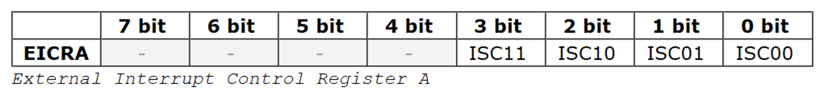
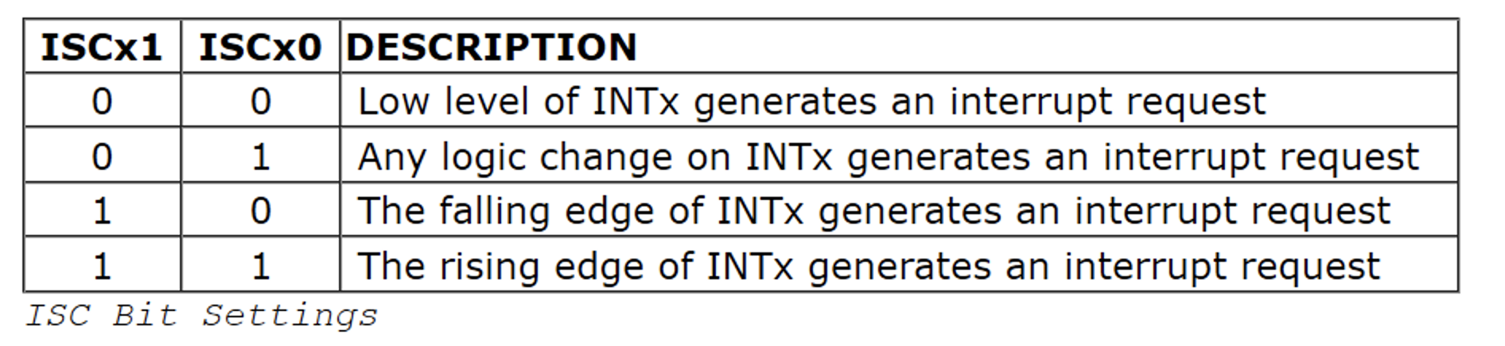
Lower level external interrupt handling
External interrupts use the 3 registers: EICRA, EIMSK, and EIFR.
EICRA(External Interrupt Control Register A)

Slide 16
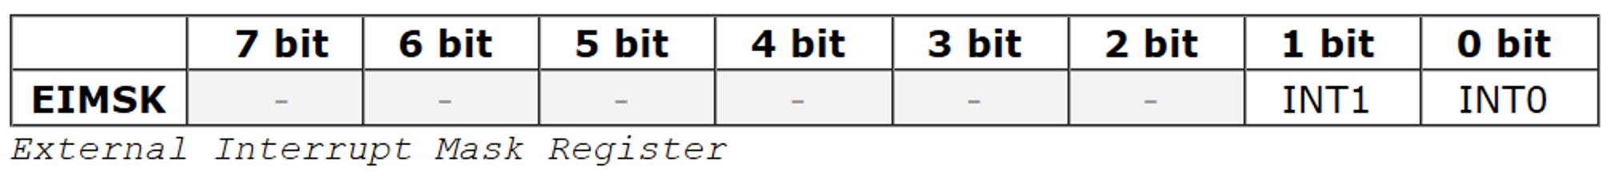
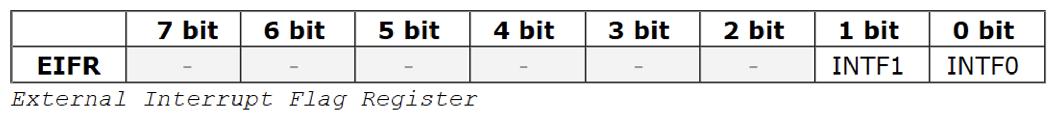
Lower level external interrupt handling
External interrupts use the 3 registers: EICRA, EIMSK, and EIFR.
EIMSK(External Interrupt Mask Register)
EIFR(External Interrupt Flag Register)
See the Arduino Example

Slide 17
Connecting an ISR to an existing interrupt service routine
For interrupts already handled by libraries, use the documented interface first. For example:
void receiveEvent (int howMany) // will be called by an built-in ISR
{
while (Wire.available () > 0)
{
char c = Wire.receive ();
// do something with the incoming byte
}
} // end of receiveEvent
void setup ()
{
Wire.onReceive(receiveEvent);
}
In this case the I₂C library is designed to handle incoming I₂C bytes internally, and then call the supplied receiveEvent function at the end of the incoming data stream.

Slide 18
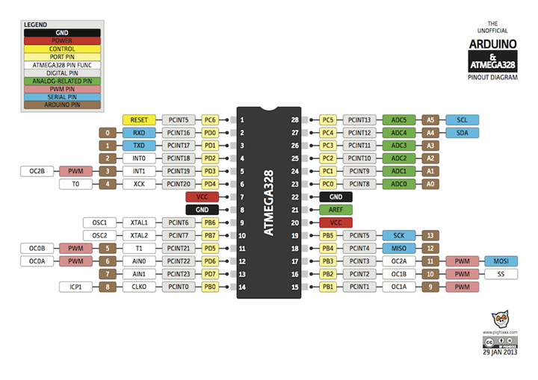
Mike Schwager’s Extension Library – EnableInterrupt- https://github.com/GreyGnome/EnableInterrupt

Slide 19
Mike Schwager’s Extension Library – EnableInterrupt- https://github.com/GreyGnome/EnableInterrupt
To use the library, first
#include “EnableInterrupt.h”
Put EnableInterrupt.h, ei_PinChange328.h, and ei_External328.h together with your sketch, i.e. in the same directory.
Attach an interrupt to an Arduino Pin to call your function “YourInterruptFunc", and acting on the "mode", which is a change in the pin's state; either RISING, FALLING, CHANGE, (or LOW only on External Interrupt pins).
Create the “YourInterruptFunc“: (Try not to put any Serial.print() statements in the function).
void YourInterruptFunc() {
...your code here...
}
In setup(), include:
enableInterrupt(pin, YourInterruptFunc, mode)

Slide 20
Mike Schwager’s Extension Library – EnableInterrupt- https://github.com/GreyGnome/EnableInterrupt
Pins that you can use for each CPU type:
ATmega328- All, except pins 0 and 1 are not recommended and not tested.
ATmega2560- 10 - 15, 18 - 21, A8 - A15, SS, SCK, MOSI, MISO
Leonardo- 0, 1, 2, 3, 7, 8, 9, 10, 11, MISO, SCK, MOSI, SS (on 3rd party boards)
Mighty1284- All, except pins 0 and 1 are not recommended. This chip has not been tested.
ATtiny44/84- All, except "pin 11" (PB3) is not defined in the support files (pins_arduino.h). The library should work to support that pin but you must modify the pins_arduino.h to support it.
ATtiny45/85- All (note that Gemma uses 3 pins for RESET, XTAL1, and XTAL2).
Due- All
Zero- All except pin 4.

Slide 21
Mike Schwager’s Extension Library – PinChangeInt https://github.com/GreyGnome/PinChangeInt
A simpler way used for Aduino UNO only.
To use the library, first
#include “PinChangeInt.h”
Put PinChangeInt.h together with your sketch, i.e. in the same directory.
Attach an interrupt to an Arduino Pin to call your function “YourInterruptFunc", and acting on the "mode", which is a change in the pin's state; either RISING, FALLING, CHANGE, (or LOW only on External Interrupt pins).
Create the “YourInterruptFunc“: (Try not to put any Serial.print() statements in the function).
void YourInterruptFunc() {
...your code here...
}
In setup(), include:
attachPinChangeInterrupt(pin, YourInterruptFunc, mode)

